Slide 1





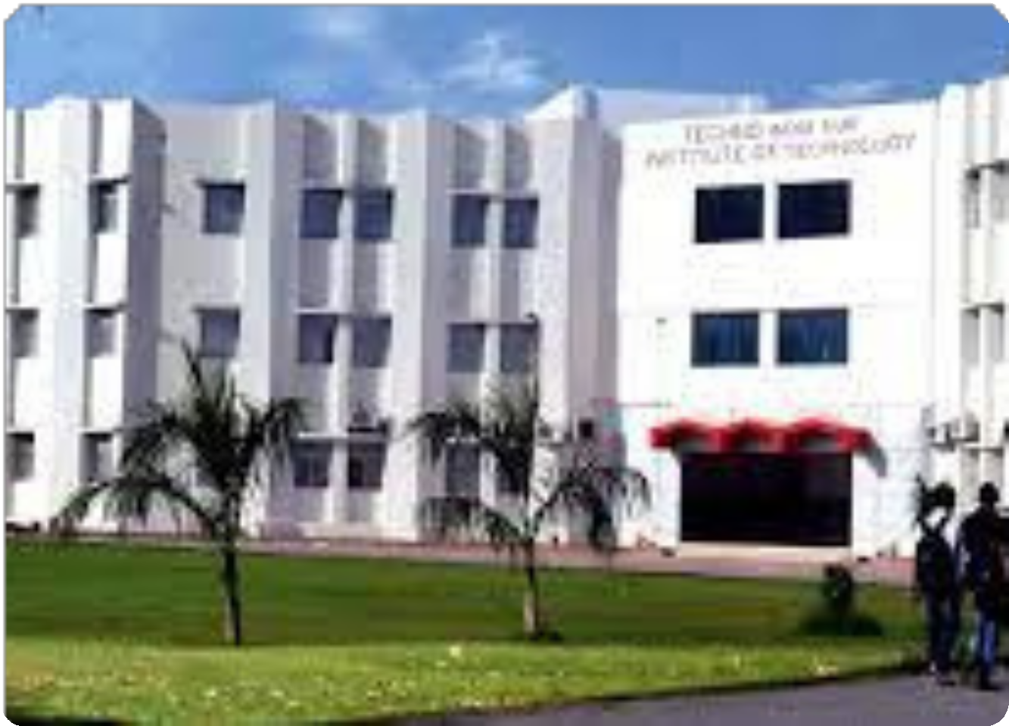
Zostel
Management
Presentation - 2024
Presented By:-
Himanshu Hada(20E1TCCSM40P052)
Bharat Kumar (20E1TCCSM30P017)
Piyush Dave (20E1TCCSM40P087)
Pratyush Jain(20E1TCCSM40P300)
Lakshit Kumawat(20E1TCCSM30P066)
Khetesh Suthar(20E1TCCSM30P061)
Divyam saini(20E1TCCSM30P036)

Slide 2






Presentation Agenda
INTRODUCTION OVERVIEW
GOALS AND OBJECTIVES MODULES
SYSTEM USE CASE DIAGRAM IMPORTANCE
REFERENCES CONCLUSION

Slide 3
INTRODUCTION
In this presentation, we delve into our comprehensive Hostel Management System, a transformative solution designed to streamline the intricacies of student accommodation and administrative operations. Within the traditional framework, managing hostels posed challenges encompassing manual processes for student enrollment, bed allocation, rent management, and overall expense tracking.

Slide 4



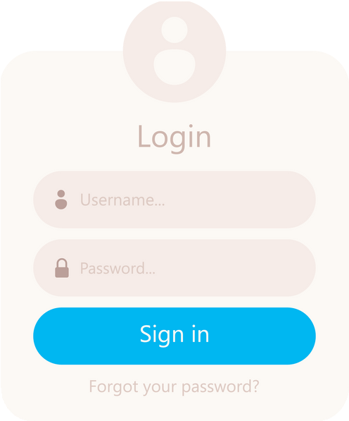




OVERVIEW
ZOSTEL MANAGEMENT SYSTEM
DASHBOARD ROOM
BEDS RENT TENANTS EXPENSES SETTING
ADMIN
SYSTEM
WELCOME TO ADMIN PORTAL
LOGIN PAGE
ADMIN PORTAL

Slide 5



GOALS AND OBJECTIVES
GOALS
Real-time Monitoring
Implement real-time monitoring of room occupancy, maintenance, and financial transactions to ensure timely decision-making and problem resolution.
Optimized Resource Utilization
Efficiently allocate and manage hostel resources, including beds and rooms, to maximize occupancy and minimize wastage.

Slide 6

GOALS AND OBJECTIVES
GOALS
Financial Transparency
Foster financial transparency
by automating rent
collection, expense tracking, and generating customizable reports for better financial control.

Slide 7
GOALS AND OBJECTIVES
OBJECTIVES
User-friendly Interface
Prioritize a user-friendly interface that is intuitive and accessible, ensuring ease of use for both administrators and residents.
Real-time Updates and Notifications
Enable real-time updates and automated notifications to keep all stakeholders informed about relevant changes, deadlines, and important information.

Slide 8
GOALS AND OBJECTIVES
OBJECTIVES
Continuous Improvement
Creating a culture of continuous improvement by gathering feedback, analyzing system performance, and implementing updates to meet evolving needs.

Slide 9


FUNCTIONAL SPECIFICATION
Rooms
In our Hostel Management System, administrators possess the ability to create rooms, edit the details of existing rooms, and also delete rooms as necessary.
Beds
In our Hostel Management System, administrators have the capability to create beds, modify the details of existing beds, and delete beds as required.

Slide 10
FUNCTIONAL SPECIFICATION
Expenses
In our system, we can manage expenses related to food, electricity, and water bills. We have the ability to create expenses for tenants and can also update or delete these expenses as needed.
Tenants
We can add new tenants, update their details, allocate rooms to them, and also delete tenants if necessary in our system.

Slide 11
IMPORTANCE
Expense Management
Centralized Data Management
Improved Communication
Data Analytics and Reporting
Less human error
Easy Data updating

Slide 12



CONCLUSION
This project allows users to enter the data through simple and interactive manner.
User is provided the option of only view the records he entered earlier.
Data storage and retrieval will become faster and easier to maintain.

Slide 13

REFERENCES
For the Hostel Management System, we have referenced the following sources:
www.w3schools.com www.google.com

Slide 14
ABOUT ZOSTEL MANAGEMENT PROJECT

Slide 15



Thank You
F o r Y o u r A t t e n t i o n
Visit Our College Site
www.technonjr.org

